Slide 1
Node js
kgr

Slide 2
UNIT-IV
Node JS Modules: Functions, Buffer, Module, Modules Types, Core Module, Local Modules and Modules Exports
Node Package Manager: What is NPM? Installing Packages Locally, installing package globally, adding dependency in package Json and Updating packages
Creating Web Server: Creating Web Server, Sending Requests and Handling HTTP requests

Slide 3
Key Features of Node.js
Single-threaded
Asynchronous
Event-driven

Slide 4
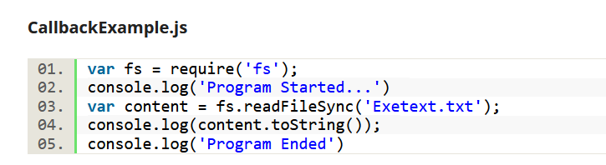
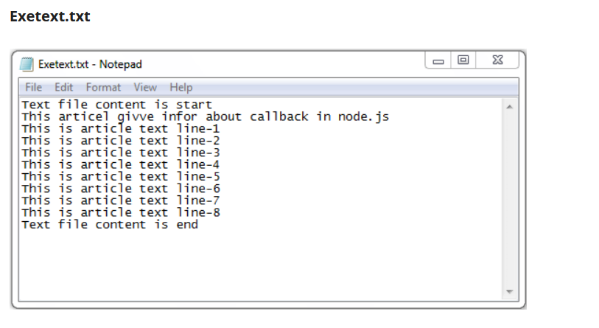

Slide 5
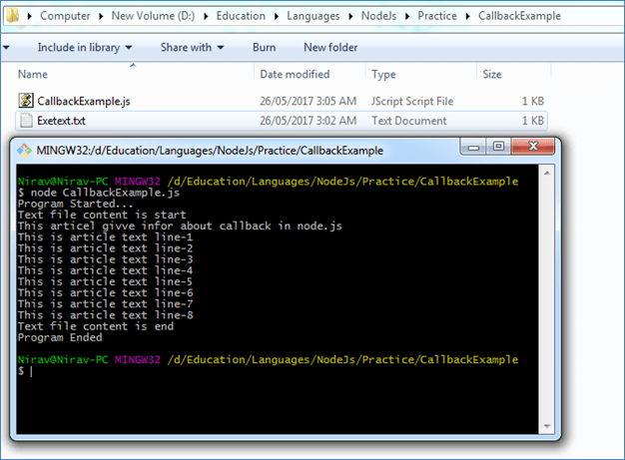

Slide 6
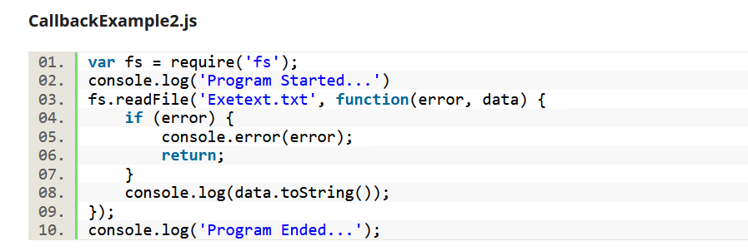

Slide 7
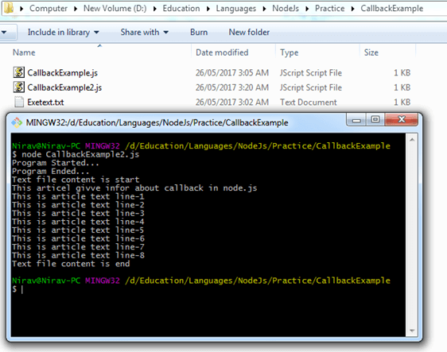

Slide 8
Events in Node.js
For creating a new event var event=require(‘events’); var eventEmitter=new event.EventEmitter();
For assigning any function to events. So, when this event is fired, the function gets executed. eventEmitter.on(‘eventName’,functionName);
For firing the events. eventEmitter.emit(‘eventName’);

Slide 9
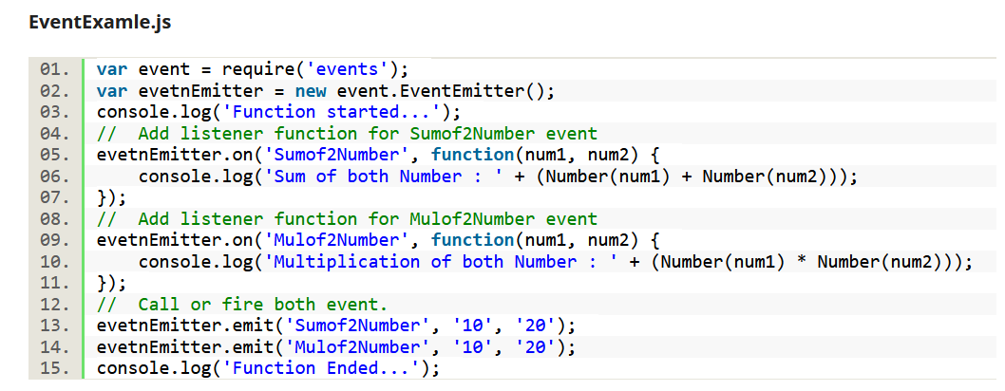

Slide 10
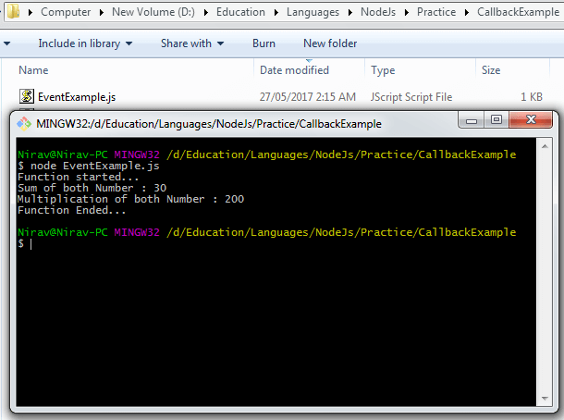

Slide 11
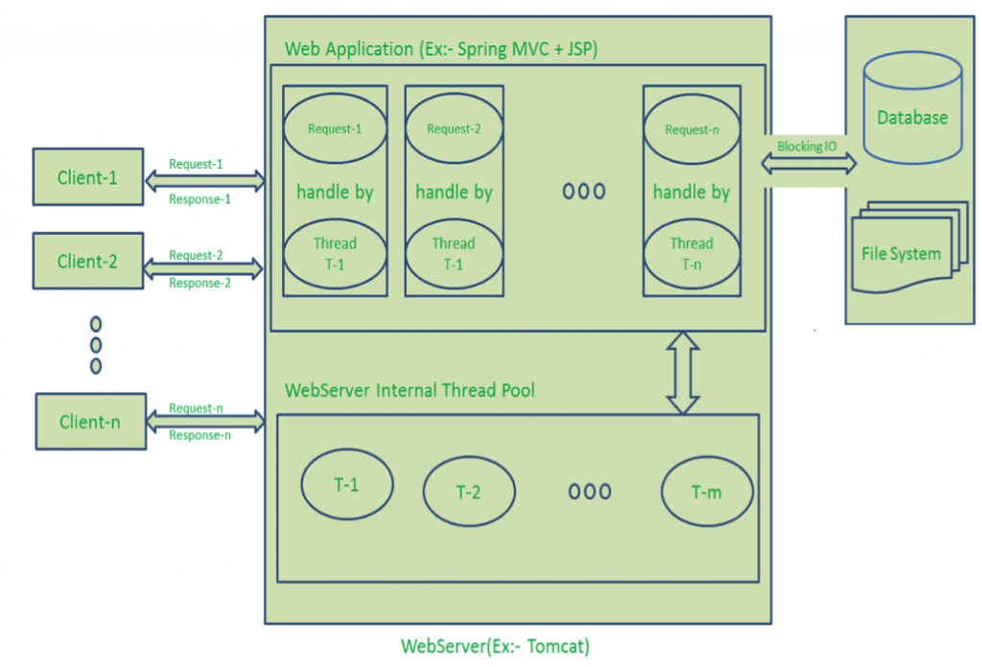

Slide 12
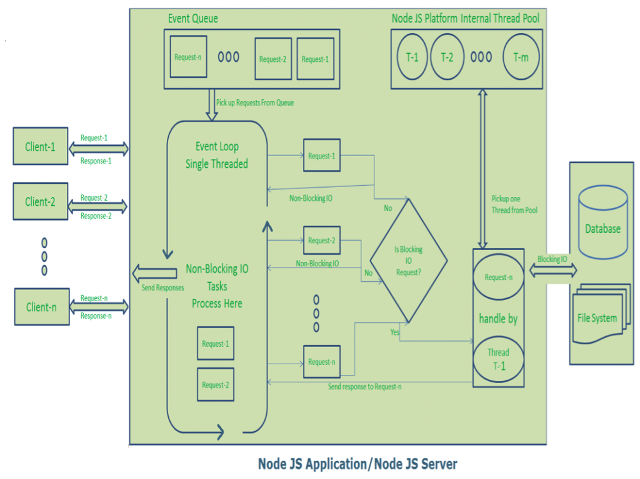

Slide 13
What are modules?
A module in NodeJS is a simple or complex JavaScript file which can be used throughout your web app. In short, each module is just a file with JavaScript code in it.

Slide 14
three types of modules
Core Modules:
These type of modules include bare minimum functionalities in Node.JS. Common examples can be:
http : to build a simple HTTP server paths : to deal with file paths fs : work with simple file input/output operations

Slide 15
Local Modules
These are the modules built by you: the programmer.
It’s good practice to write modules as it promotes cleanliness of your code and make your code modular(you can reuse your module in other projects without a lot of additional effort)

Slide 16
Third Party Modules
These types of modules are built by the programming community. They mostly include complex code so that the programmer can add functionality to his app without writing it himself. This way, he saves time as well.

Slide 17
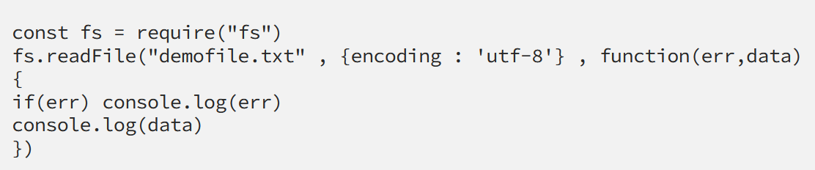
How can I use these modules?
When using modules, you simply use the function require()
fsExample.js

Slide 18
Contd.,
The first parameter is the name of the text file you wish to read
Second parameter is your options : here, encoding method is ‘utf-8’ so that text can be printed out. If you don’t specify the options, it will print out buffer values, which are unreadable to humans.
Third parameter is the callback function.

Slide 19
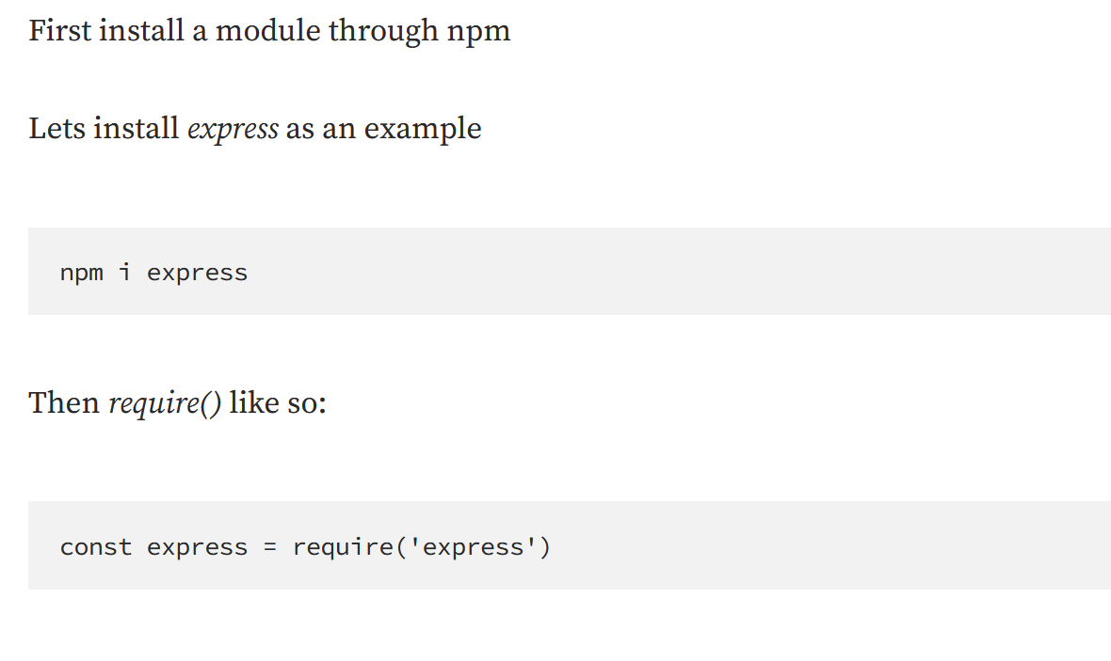
Using Third Party Modules

Slide 20
Contd.,
NPM is a package manager for the Node.JS framework, meaning , a programmer can download third party modules so that He / She can use those modules in the project. These modules are built by the programming community.
express — makes the process of writing web apps easier morgan — logs HTTP requests, and gives the developer concise insight on how his app is being used

Slide 21
Using local modules
To use your own modules(local modules) , you have to ‘export’ it first. You can export strings, functions , variables etc.
Syntax is as follows:

Slide 22
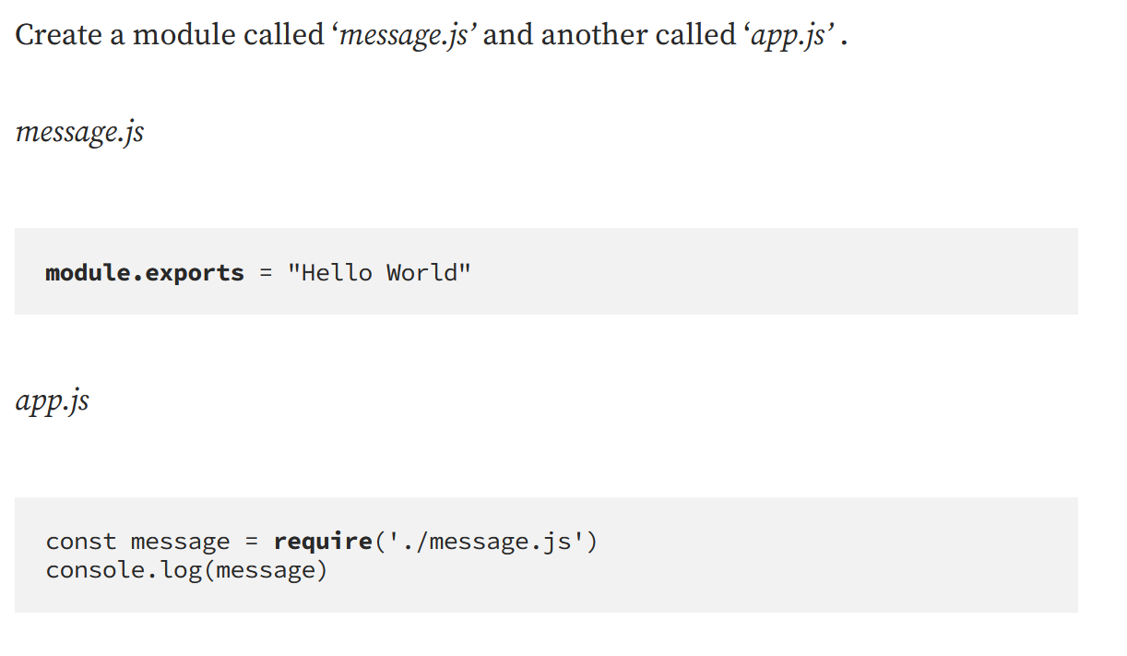

Slide 23
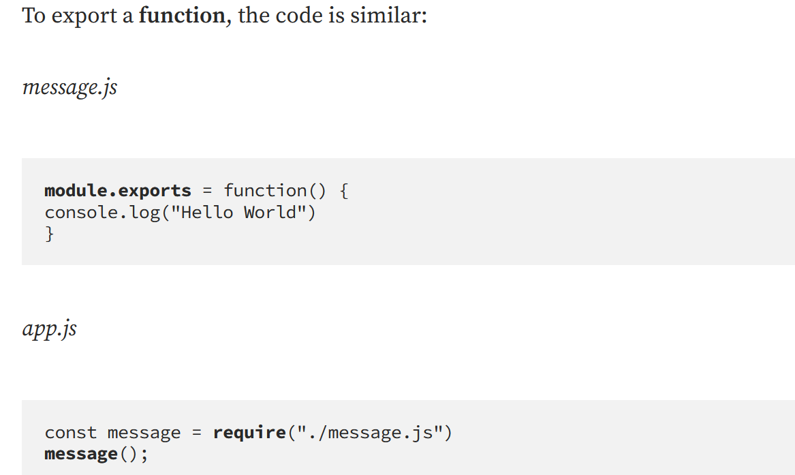

Slide 24
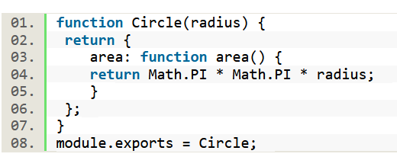
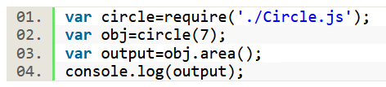
Circle.js
app.js

Slide 25
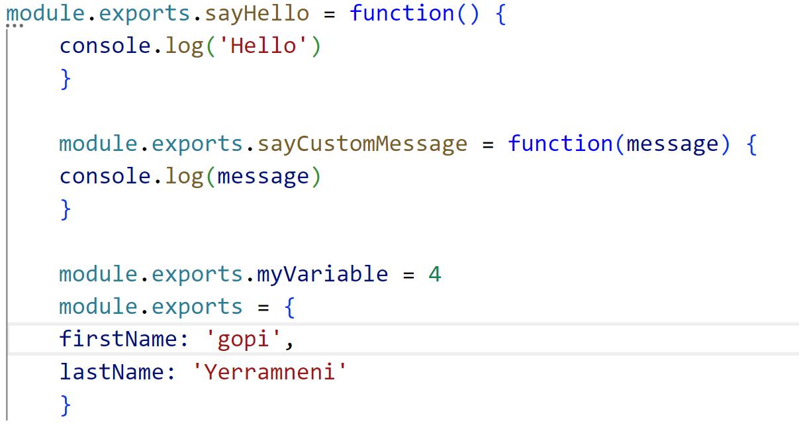
Exports object
exports is an object. Thus , you can add properties to it.
message.js

Slide 26
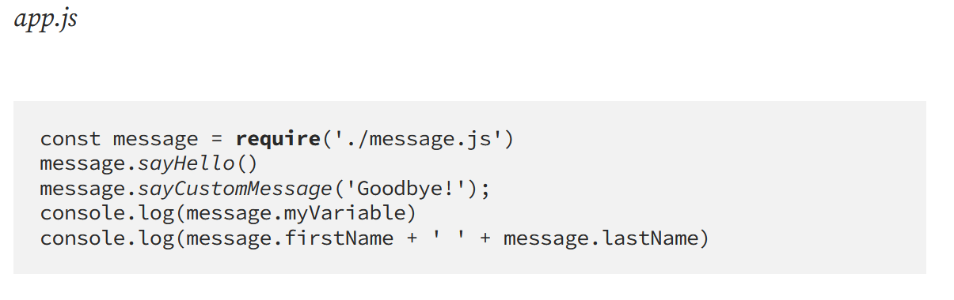

Slide 27
The Basics of NPM
NPM is a package manager for the Node.JS framework, meaning , a programmer can download third party modules so that he can use those modules in his project. These modules are built by the programming community.
Common examples can be:
express — makes the process of writing web apps easier morgan — logs HTTP requests, and gives the developer concise insight on how his app is being used

Slide 28
How to install Node JS
Installing Node.js
In Windows
Goto Node.js download site @ https://nodejs.org/en/download/ ⇒
Choose "LTS" (Long-Term Support) ⇒
Download "Windows Binary (.zip)" and "64-bit" (e.g., "node-v12.16.1-win-x64.zip" - 18MB) ⇒
Unzip into a directory of your choice, denoted as "Node.js installed directory".
Add the "Node.js installed directory" to your PATH environment variable.

Slide 29
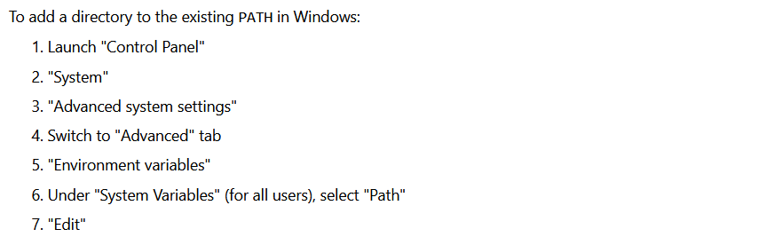

Slide 30
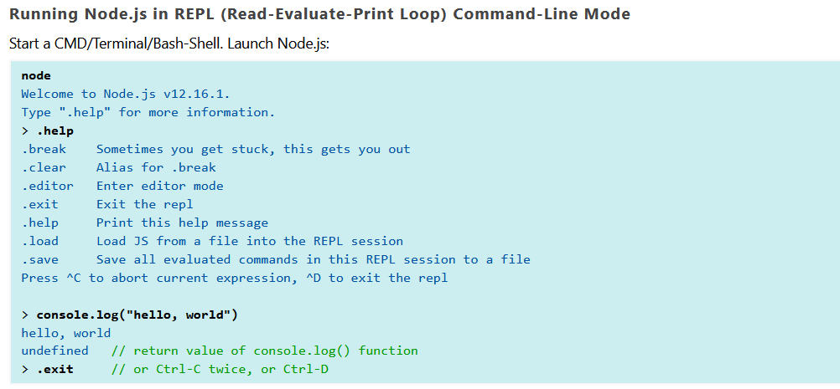
Getting Started with Node.js

Slide 31
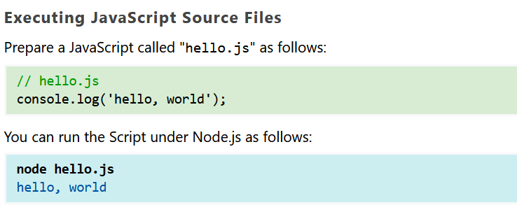

Slide 32
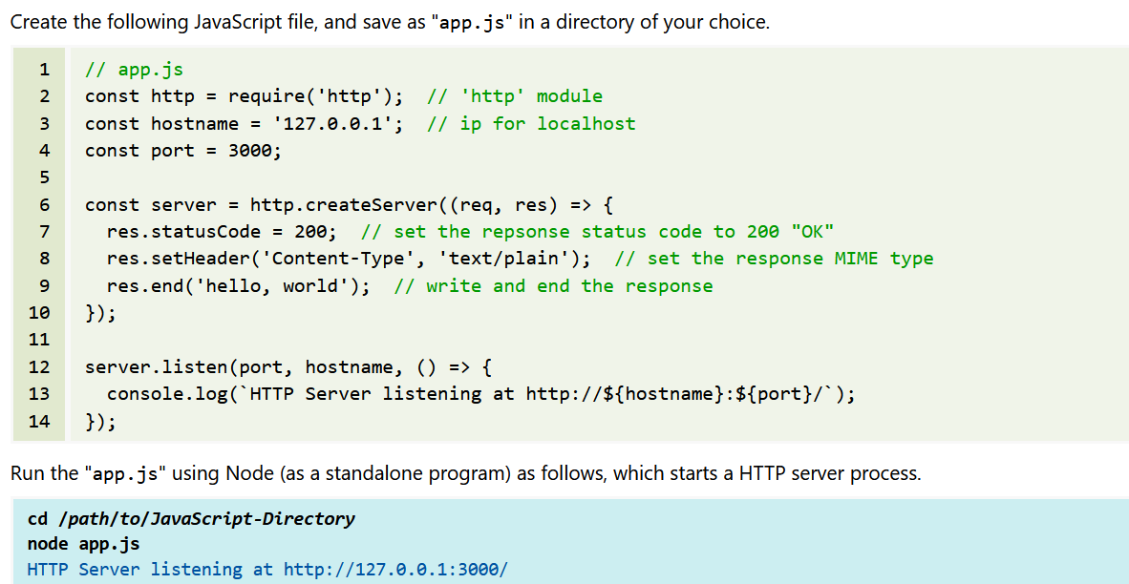
Node.js as a Web Server

Slide 33

Using NPM through the Command Line
First, create a directory for your project with your JavaScript file in it.
Then, within the same directory, run the command

Slide 34
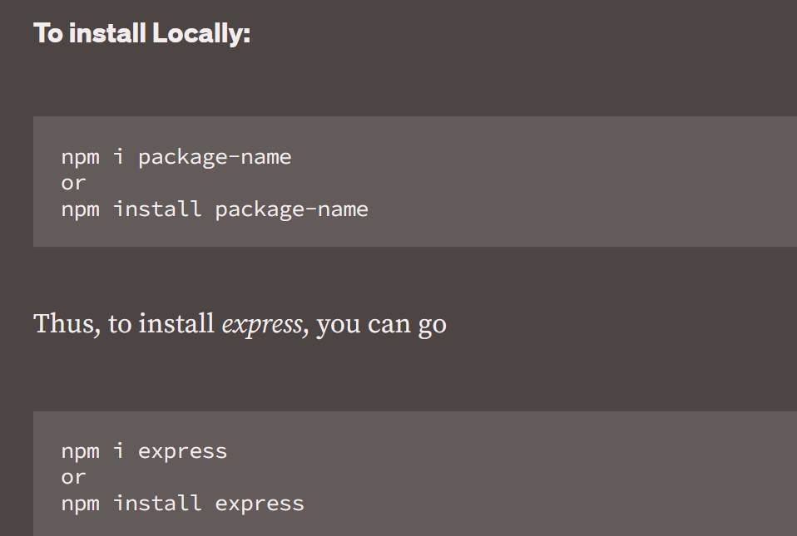
Note:i is just an alias to install. They both can be used interchangeably

Slide 35
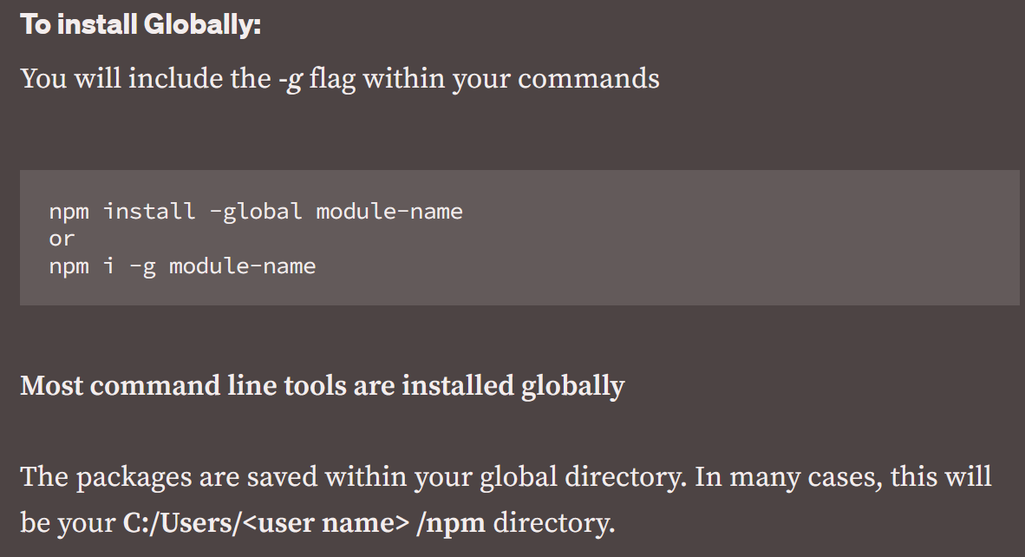

Slide 36
Additional npm commands
npm help
--To see all main commands:
npm -v
--To get version of npm
npm install express@4.2.0
--To install exact version of a package eg. express:
npm install express@latest
--To install latest version(this is useful when a package requires an update):

Slide 37
npm install express --save
npm install express -S
npm install mocha -D
npm install mocha --save-dev
--To explicitly save into your package.json file(-S or — save )
or into your devDependencies( — save-dev or -D):
npm install express --exact
npm install express -E
--Sometimes, programmers avoid npm’s versioning system ,
or they want to use the exact version of a package.
To do so, use — exact or -E:

Slide 38
Contd.,
npm i react react-dom babel babel-core -ED
--You can even install more than one package and include multiple flags within one command:
To update npm to its latest version, type
--npm i -g npm@latest

Slide 39
File System: Read File, writing a File, opening a File Deleting a File, Writing a file asynchronously and Other I/O Operations
Events: Event Emitter class, Inheriting Events and Returning event emitter

Slide 40
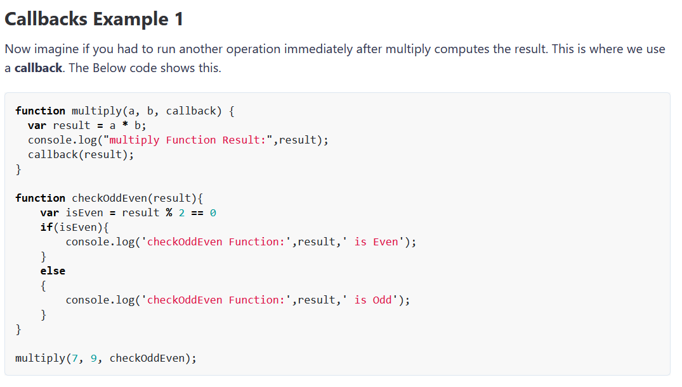

Slide 41
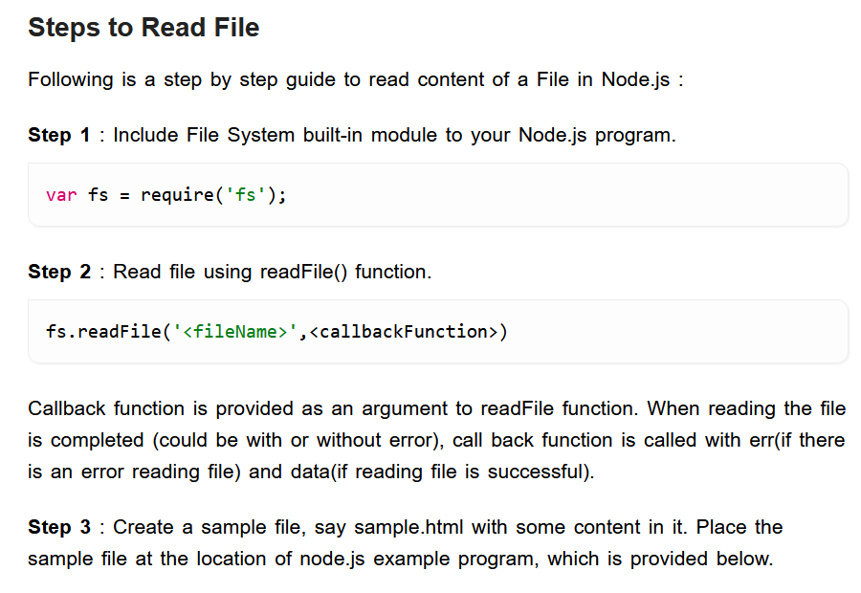

Slide 42
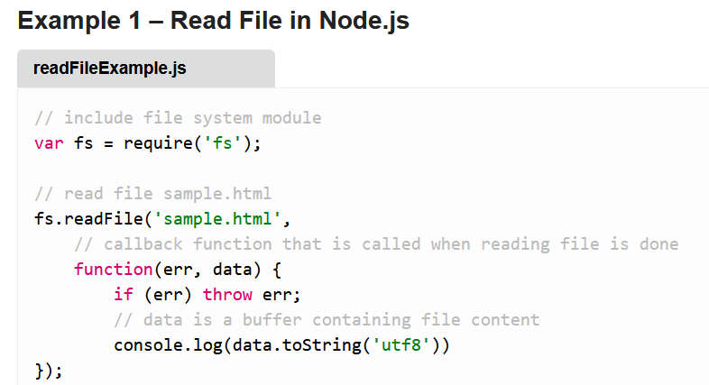
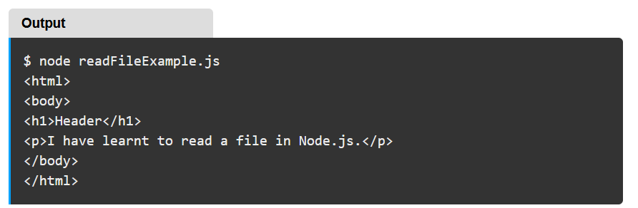

Slide 43
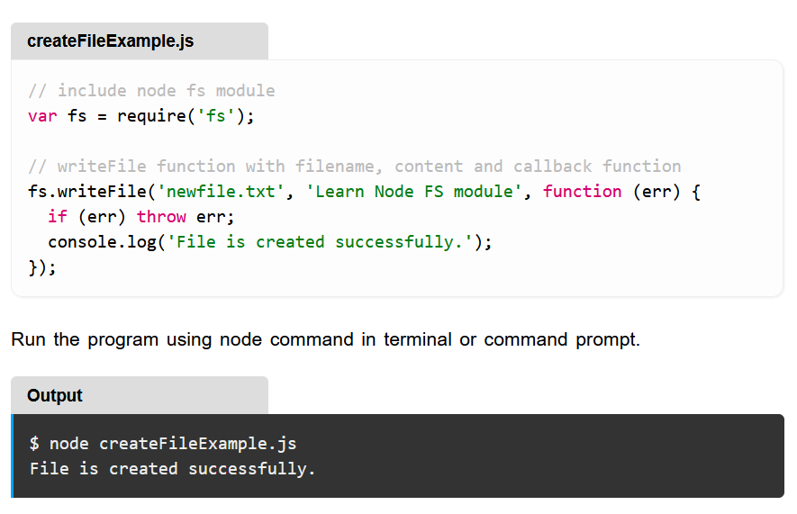

Slide 44
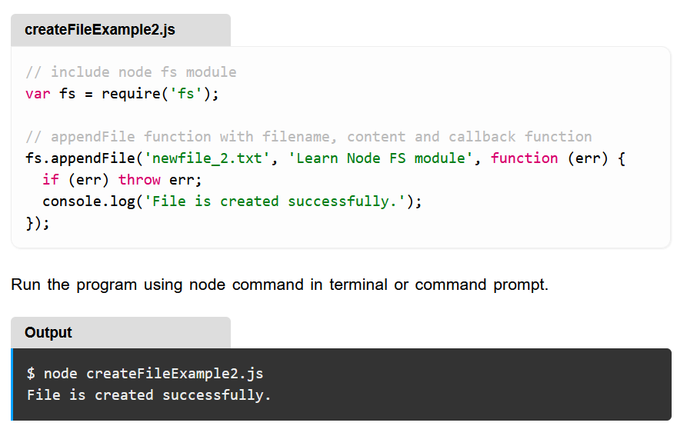

Slide 45
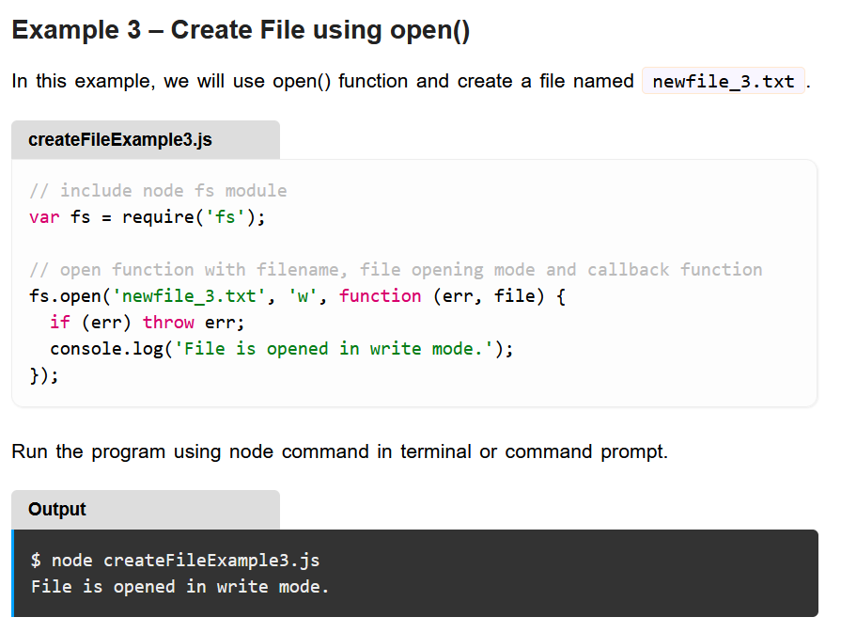

Slide 46
Flag | Description
r | Open file for reading. An exception occurs if the file does not exist.
r+ | Open file for reading and writing. An exception occurs if the file does not exist.
rs | Open file for reading in synchronous mode.
rs+ | Open file for reading and writing, telling the OS to open it synchronously. See notes for 'rs' about using this with caution.
w | Open file for writing. The file is created (if it does not exist) or truncated (if it exists).
wx | Like 'w' but fails if path exists.
w+ | Open file for reading and writing. The file is created (if it does not exist) or truncated (if it exists).
wx+ | Like 'w+' but fails if path exists.
a | Open file for appending. The file is created if it does not exist.
ax | Like 'a' but fails if path exists.
a+ | Open file for reading and appending. The file is created if it does not exist.
ax+ | Like 'a+' but fails if path exists.

Slide 47
Delete a File
The fs.unlink() method is used to remove a file or symbolic link from the file system.
This function does not work on directories, therefore it is recommended to use fs.rmdir() to remove a directory.
fs.unlink(path, callback);

Slide 48
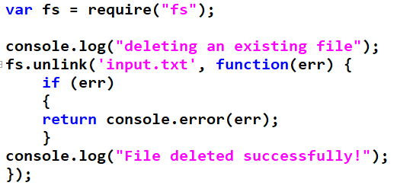

Slide 49
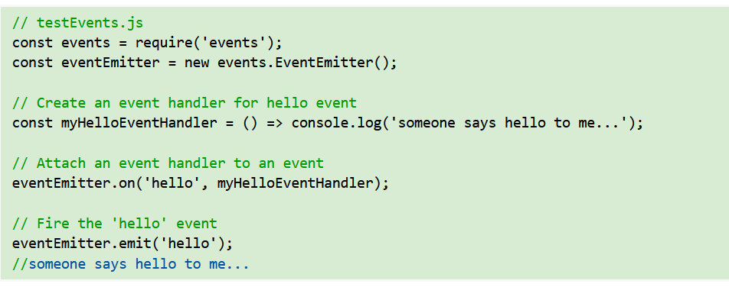

Slide 50
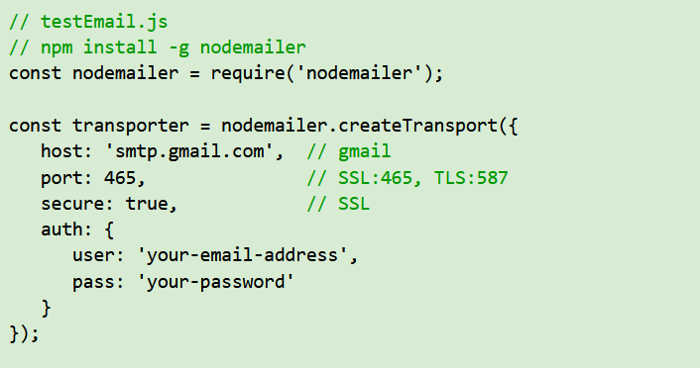
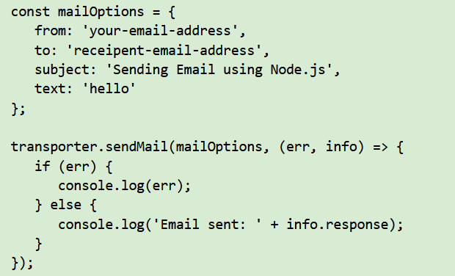
NodeMailer ('nodemailer') Module for Sending Email

Slide 51
Note:
You need to check your SMTP server's hostname/port, and whether SSL/TLS is used.
For "gmail", the SMTP server's hostname/port is shown. You also need to "Enabled Less Secure Apps". Goto "Manage your google account" ⇒ security ⇒ "Less secure app access" ⇒ "on".

Slide 52
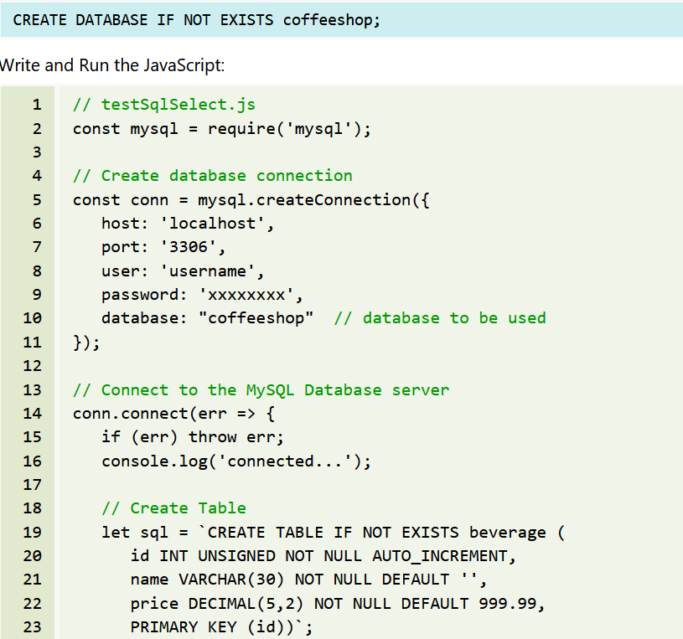
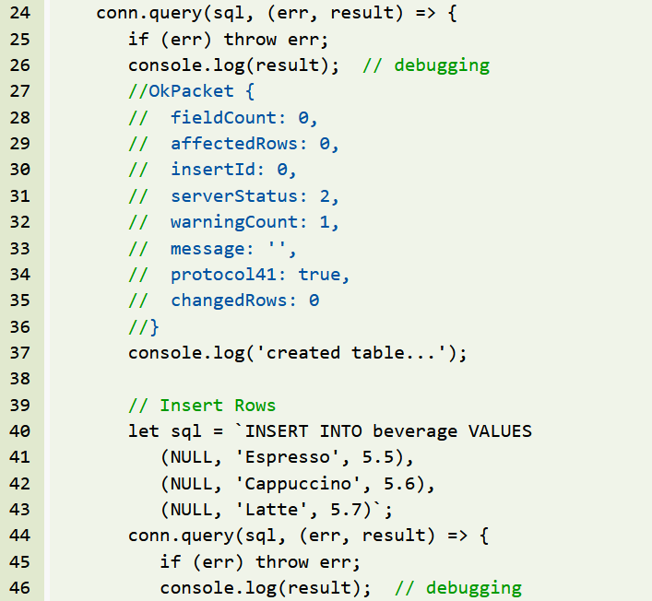
Node.js Database Programming

Slide 53
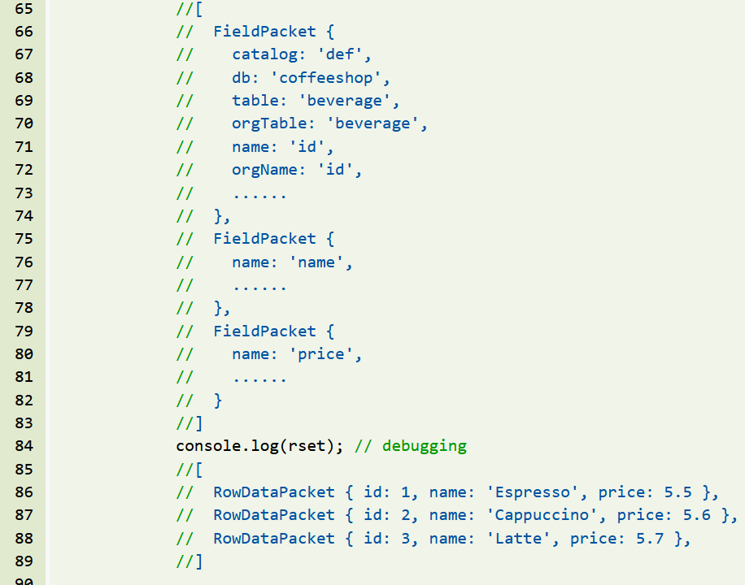
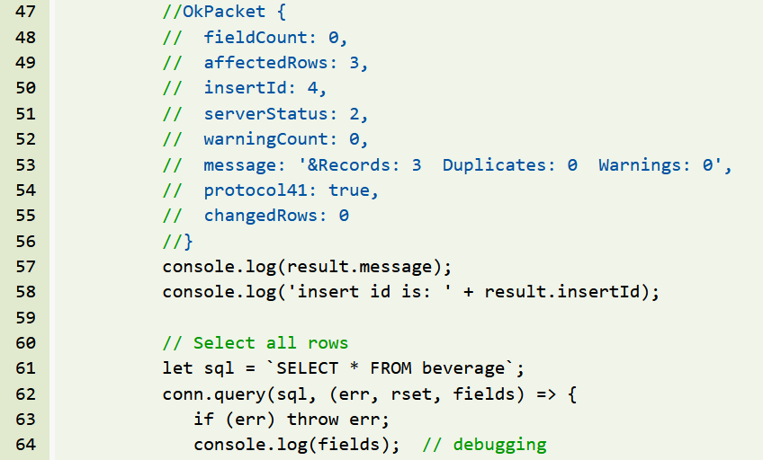

Slide 54
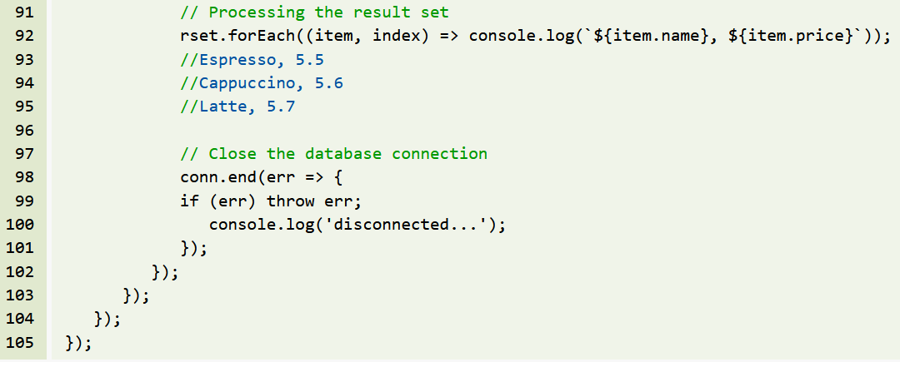

Slide 55
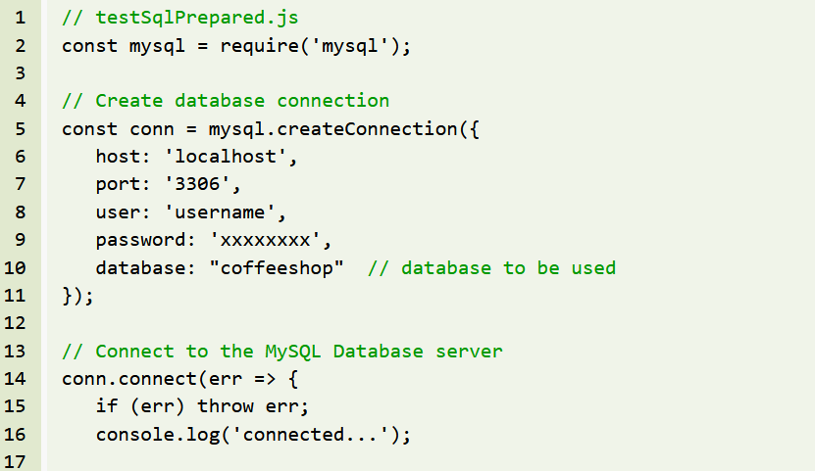

Slide 56
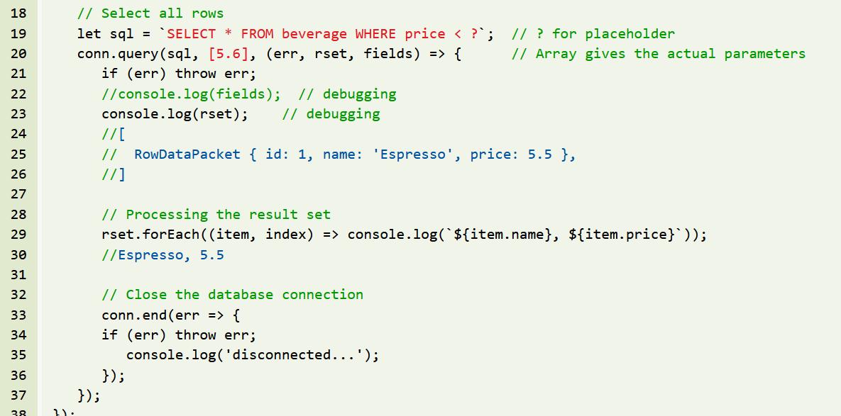

Slide 57
references
https://www3.ntu.edu.sg/home/ehchua/programming/webprogramming/NodeJS_Basics.html#zz-2.1

Slide 58
UNIT-V
Mongo DB: Introduction, Importance of NoSQL databases, JSON features, Data types and examples. CRUD Operations, Data Modelling & Schema Design, Indexing and Aggregation, Mongo Import/Export and Master/Slave Replication.

Slide 59
Intro
MongoDB is the most popular and trending database.
The vendor: MongoDB
https://www.mongodb.com/
Where we can use MongoDB database?
----------------------------------
We can use everywhere
For desktop applications, for mobile applications
For web applications, this database is more popular.

Slide 60
Who will use
Full stack developer:
stack---->The technologies which can be used to develop web applications are called a stack.
The most popular stacks:
1. MEAN Stack
2. MERN Stack
1. MEAN Stack:
--------------
2. MERN Stack:
--------------
M --->MongoDB
E --->Express
R --->React JS
N --->Node JS

Slide 61
Contd.,
By using MEAN and MERN stacks we can build javascript based web applications.
Node JS is based on Java Script
React or Angular is based on Java Script
Express is based on Java Script
MongoDB is also based on Java Script.
MongoDB internally used Mozilla's Java Script Engine.

Slide 62
Relational Database vs Document Database:
There are 2 most common types of databases.
1. Relational Databases/SQl Databases
2. Document Databases/NoSQl Databases
1. Relational Databases/SQl Databases
--------------------------------------
The data will be stored in tables and these tables has fixed schema.
Employee(eno,ename,esal,eaddr)
The data stored in tables has relationships like
The data stored in tables has relationships like
one to one
one to many
many to one
etc

Slide 63
2. Document Databases/NoSQl Databases:
--------------------------------------
Data will be stored in separate documents and each document is independent of others.
eg: MongoDB
MongoDB Structure:
------------------
MongoDB Physical database contains several logical databases.
Each database contains several collections. Collection is something like table in relational database.
Each collection contains several documents. Document is something like record/row in relational database.

Slide 64
eg:
Database: Shopping cart database
Collections: Customers, Products, Orders
Cusomer Collection: contains several documents
document1:
{
"Name":"Sunny",
"age":40,
"Salary":10000
}
document2:
{
"Name":"Durga"
}
document-3:
{
"name":"Bunny",
"age":30,
"address":
{
"city":"Hyderabad"
},
"hobbies":[
{"name":"Cricket playing"},
{"name":"swimming"}
]
}

Slide 65
How data represented in MongoDB?
In JSON (BSON) Format.
JSON--->Java Script Object Notation
BSON--->Binary JSON

Slide 66
Key Characteristics of MongoDB database: ----------------------------------------
Installation and setup is very easy.
1. All information related to a document will be stored in a single place.
To retrieve data, it is not required to perform join operations and hence retrieval is very fast.
2. Documents are independent of each other and no schema. Hence we can store unstructured data like videos, audio files etc
3. We can perform oprations like editing existing document, deleting document and inserting new documents very easily.
4. Retrieval data is in the form of json which can be understandable by any programming language without any conversion (interoperability)
5. We can store very huge amount of data and hence scalability is more.
Note: Performance and Flexibility are biggest assets of Mongodb.

Slide 67
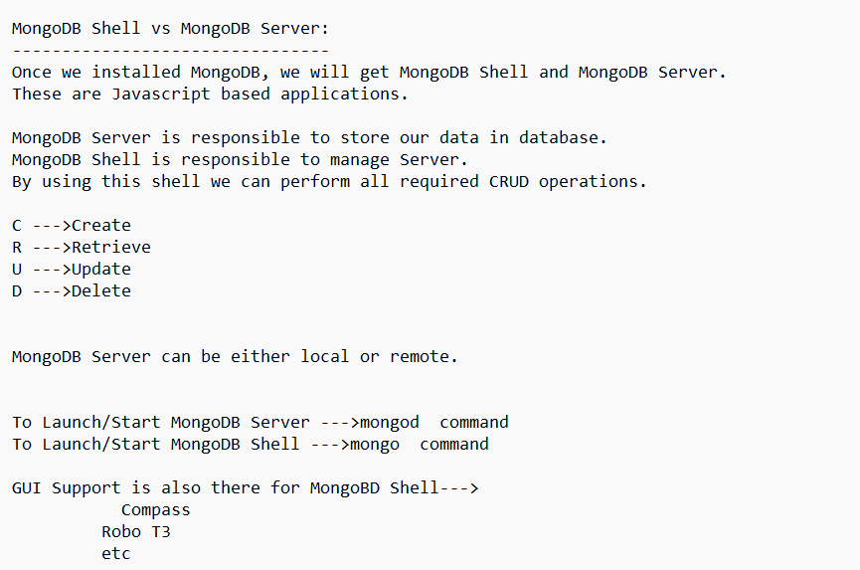

Slide 68
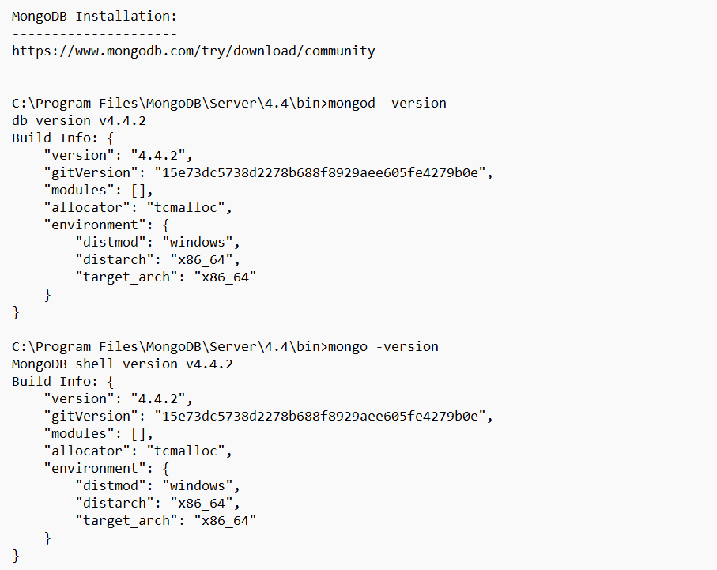

Slide 69
Data diretotry
Create the data directory or specify another path using (1) the --dbpath command line option, or (2) by adding the 'storage.dbPath' option in the configuration file."}}
mongod --dbpath "C:\data\db"

Slide 70
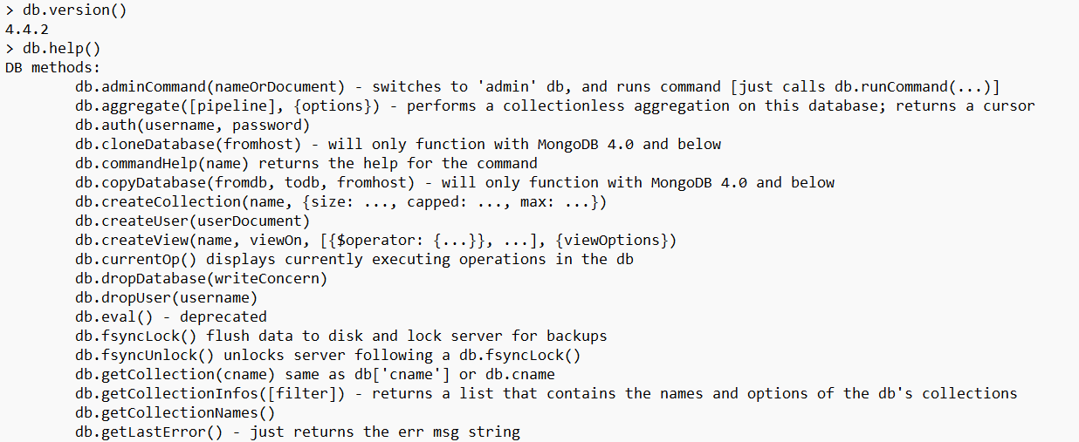

Slide 71
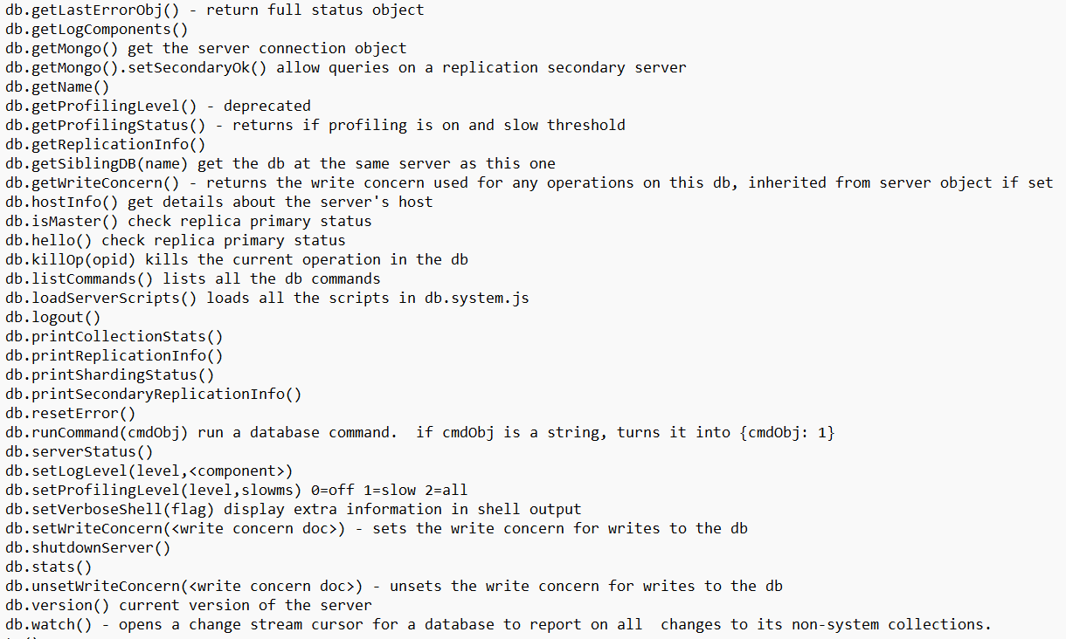

Slide 72
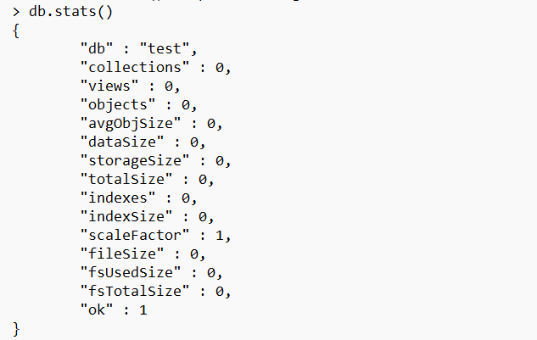

Slide 73
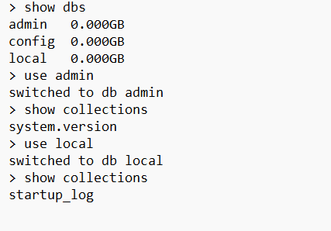

Slide 74
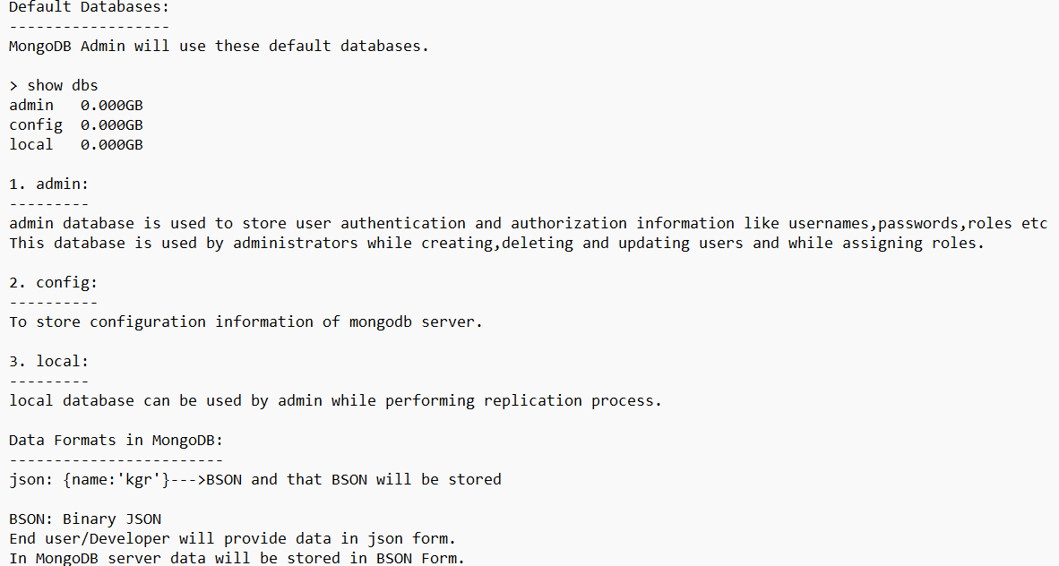

Slide 75
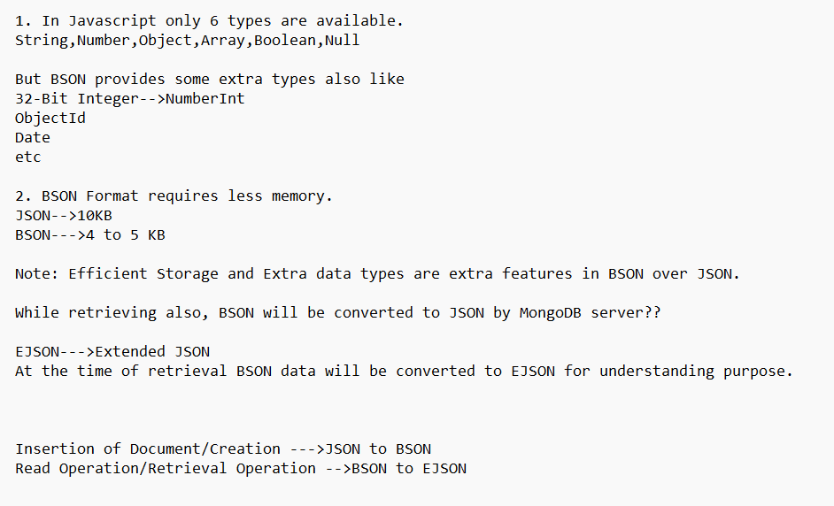

Slide 76
Q. What data formats used in MongoDB?
3 formats: JSON,BSON,EJSON

Slide 77
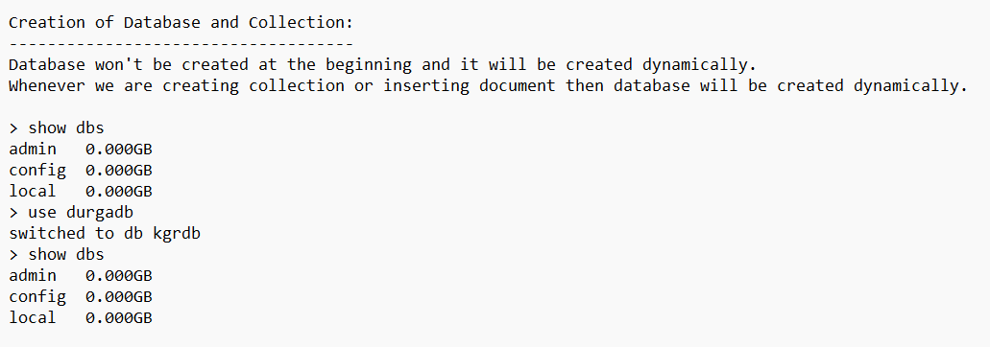

Slide 78


Slide 79


Slide 80


Slide 81


Slide 82


Slide 83


Slide 84


Slide 85


Slide 86


Slide 87


Slide 88
Q. What is capped collection?
If size exceeds or maximum number of documents reached, then oldest entry will be deleted automatically, such type of collections are called capped collections.

Slide 89


Slide 90


Slide 91


Slide 92



Slide 93


Slide 94


Slide 95


Slide 96


Slide 97
Note:
mongoimport creates database and collection automatically if not available.
If collection already available then the new documents will be appended.

Slide 98
> use rahuldb
switched to db rahuldb
> show collections
students9

Slide 99


Slide 100


Slide 101


Slide 102


Slide 103


Slide 104


Slide 105


Slide 106


Slide 107


Slide 108


Slide 109


Slide 110


Slide 111


Slide 112
While performing bulk insert operation, if any document insertion fails then rest of the documents won't be inserted. i.e in bulk inserts, order is important.
The documents which are already inserted won't be rollbacked.
We can customize this behavior by using ordered property.
> db.cars.insertMany([{},{},...{}],{ordered: false})
The default value for ordered is true.

Slide 114


Slide 115
U--->Update Operation

Slide 116
We can perform updations like
1. Overwrite existing value of a particular field with our new value
2. Add a new field for selected documents
3. Remove an existing field
4. Rename an existing field

Slide 117
update methods:
We can perform required updations by using update methods and update operators.
There are 3 update methods are avaialble.
1. updateOne()
2. updateMany()
3. update()

Slide 118
1. updateOne():
db.collection.updateOne(filter,update,options)
It finds the first document that matches filter criteria and perform required updation. It will perform updation for a single document.
2. updateMany():
db.collection.updateMany(filter,update,options)
To update all documents that match the specified filter criteria.
3. update():
db.collection.update(filter,update,options)
We can use this method to update either a single document or multiple documents.
Bydefault this method updates a single document only.

Slide 119


Slide 120


Slide 121


Slide 122


Slide 123


Slide 124


Slide 125



Slide 126



Slide 128
2. $unset operator:
To delete the specified field.
3. $rename operator:
We can use $rename operator to rename fields, ie to change name of the field.
Q: Write Query to rename esal as salary and eaddr as city in employees collection?
> db.employees.updateMany({},{$rename: {esal:"salary", eaddr: "city"}})

Slide 129
4. $inc operator:
inc means increment.
We can use $inc to increment or decrement value of the field with specified amount.
Increment all employee salary by 500.
>db.employees.updateMany({},{$inc: {esal:500}})
Decrement Employee salary by Rs 1 where esal is > 4700?
> db.employees.updateMany({esal:{$gt: 4700}},{$inc: {esal:-1}})

Slide 130


Slide 131


Slide 132


Slide 133


Slide 134


Slide 135


Slide 136


Slide 137


Slide 138


Slide 139


Slide 140


Slide 141


Slide 142


Slide 143


Slide 144


Slide 145


Slide 146


Slide 147
Deleting Documents from the collection:
---------------------------------------
MongoDB provides the following methods to delete documents from the collection.
1. deleteOne()
2. deleteMany()
3. remove()

Slide 148


Slide 149


Slide 150


Slide 151


Slide 152


Slide 153


Slide 154


Slide 155


Slide 156


Slide 157


Slide 158


Slide 159


Slide 160


Slide 161


Slide 162


Slide 163


Slide 164


Slide 165


Slide 166



Slide 167


Slide 168
Indexing

Slide 169

aggregation

Slide 170


Slide 171



Slide 172


Slide 173


Slide 174


Slide 175


Slide 176


Slide 177


Slide 178


Slide 179


Slide 180


Slide 181


Slide 182


Slide 183
Indexing
Indexing is DBMS related concept and almost every database provides support.
Indexes supports efficient execution of queries in MongoDB.
Indexing concept is very helpful for find,update and delete queries.
The main objective of indexing is to improve performance.
Without indexes, server will scan all documents present in the collection to find matched documents. This is called Collection Scan(COLLSCAN).
Whenever we are defining index, MongoDB Server will store values of indexed field in B-Tree Data structure in specified sorting order.
To find matched documents, we are not required to scan all documents,server can identify matched documents directly based Index Scan(IXSCAN).
As the number of documents to be scan, is reduces and hence performance will be improved.

Slide 184


Slide 185
General Rules for MongoDB Schema Design:
Rule 1: Favor embedding unless there is a compelling reason not to.
Rule 2: Needing to access an object on its own is a compelling reason not to embed it.
Rule 3: Avoid joins and lookups if possible, but don't be afraid if they can provide a better schema design.
Rule 4: Arrays should not grow without bound. If there are more than a couple of hundred documents on the many side, don't embed them; if there are more than a few thousand documents on the many side, don't use an array of ObjectID references. High-cardinality arrays are a compelling reason not to embed.
Rule 5: As always, with MongoDB, how you model your data depends entirely on your particular application's data access patterns. You want to structure your data to match the ways that your application queries and updates it.

Slide 186
https://www.mongodb.com/developer/products/mongodb/mongodb-schema-design-best-practices/

